Slide 1
Learnin
rammin
at orm
e East Ex
ansion
By Sumiya Tabassum

Slide 2
Speaker's Name: Sumiya Tabbasum

Slide 3
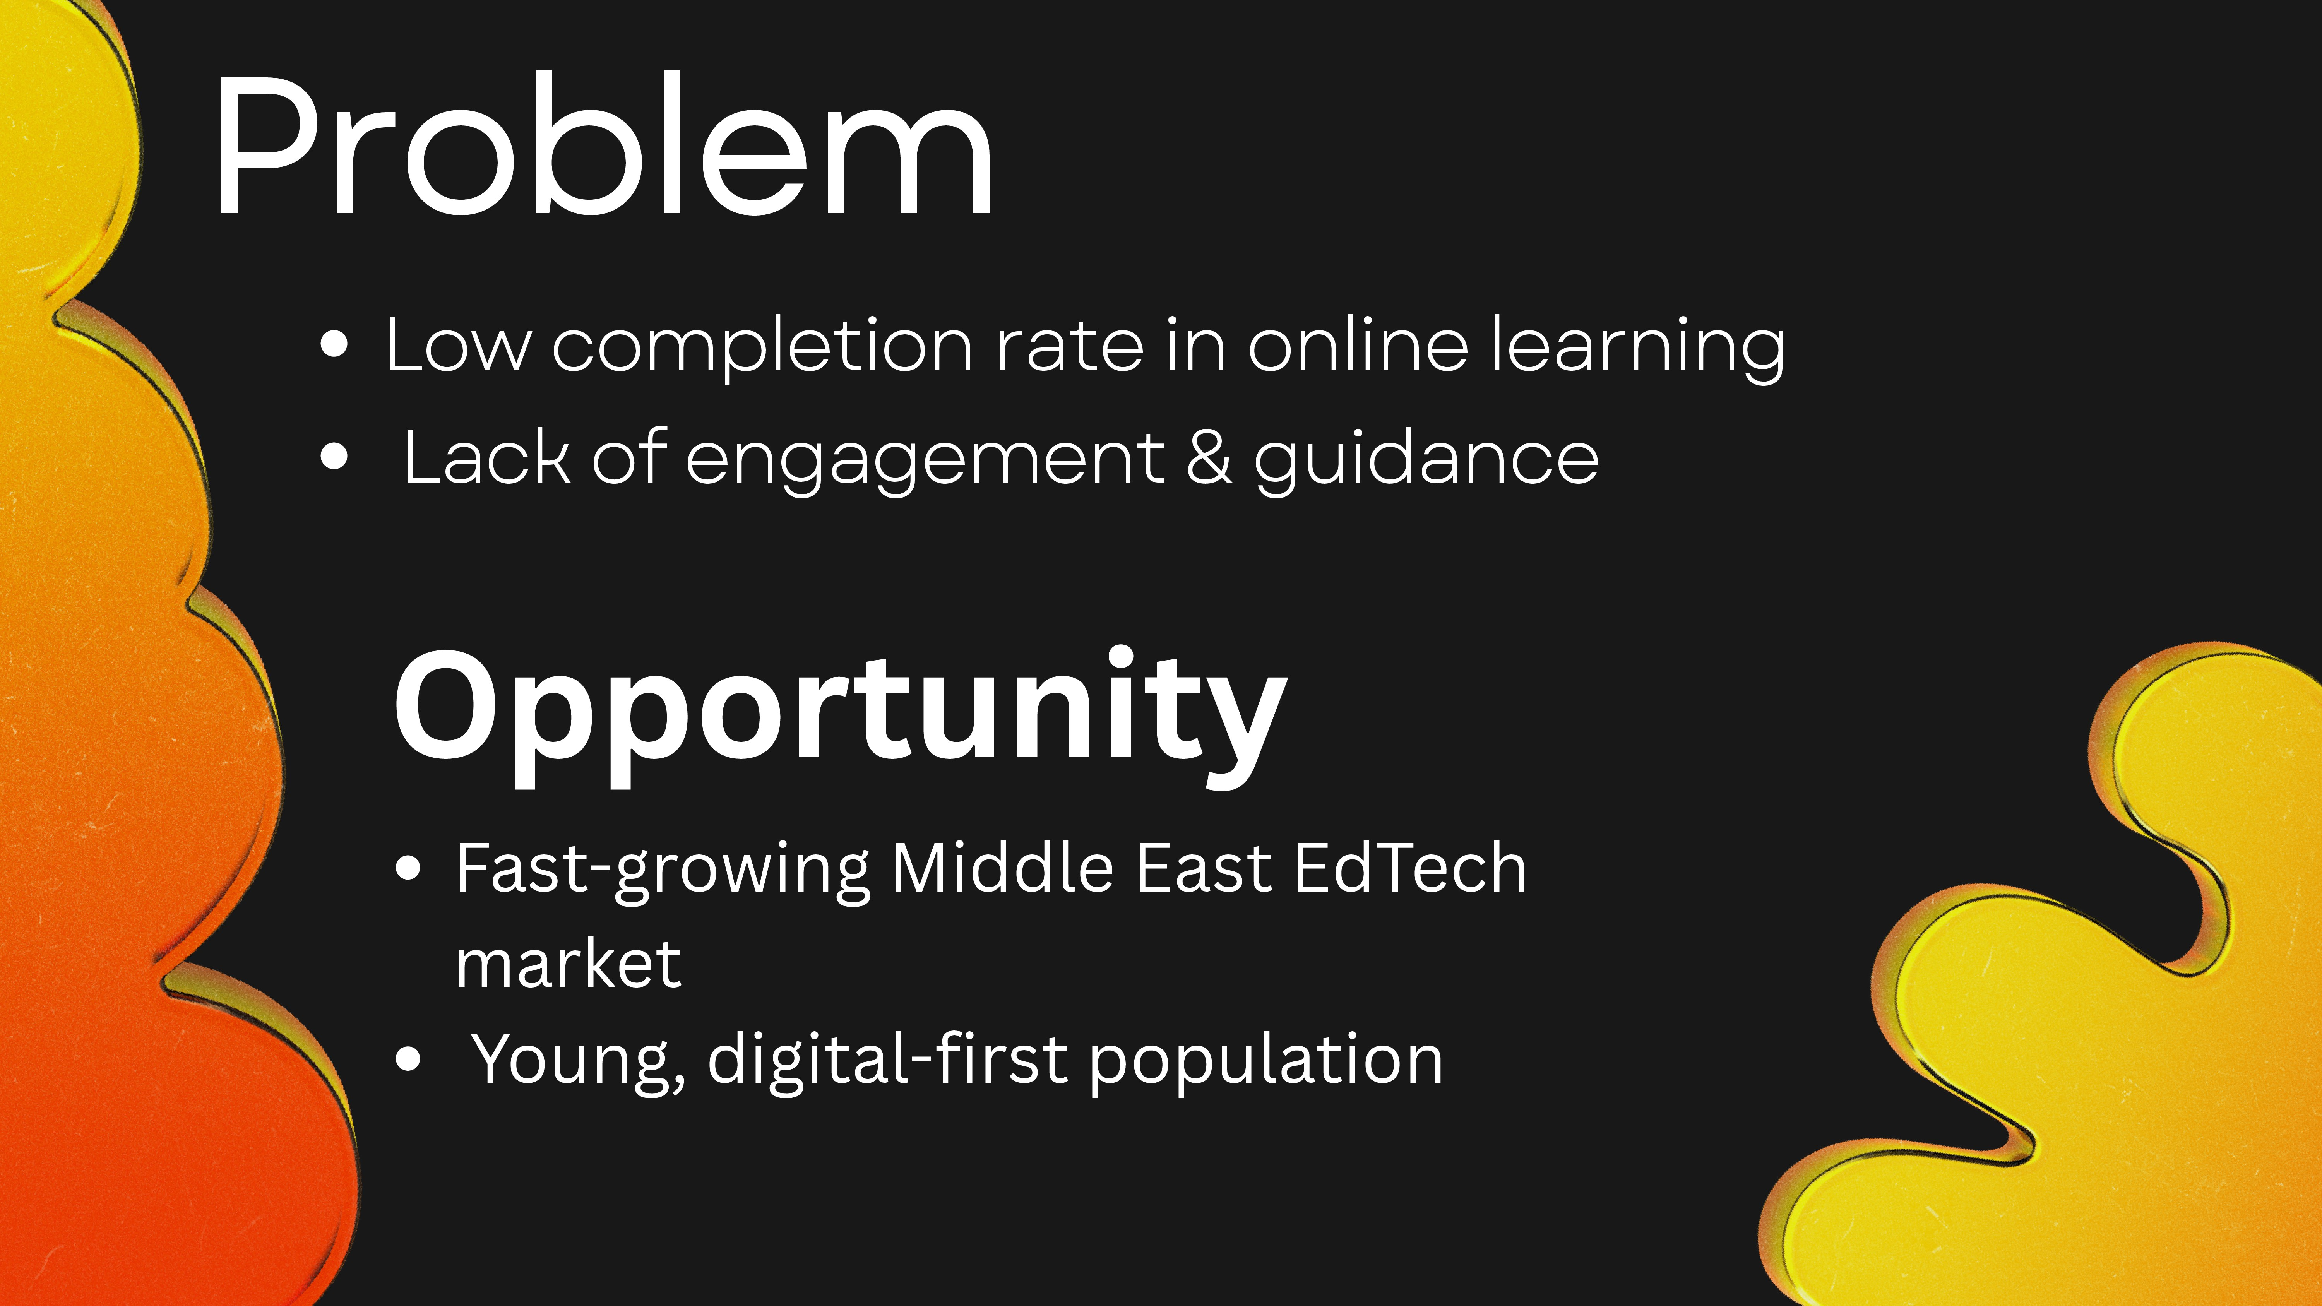

Slide 4
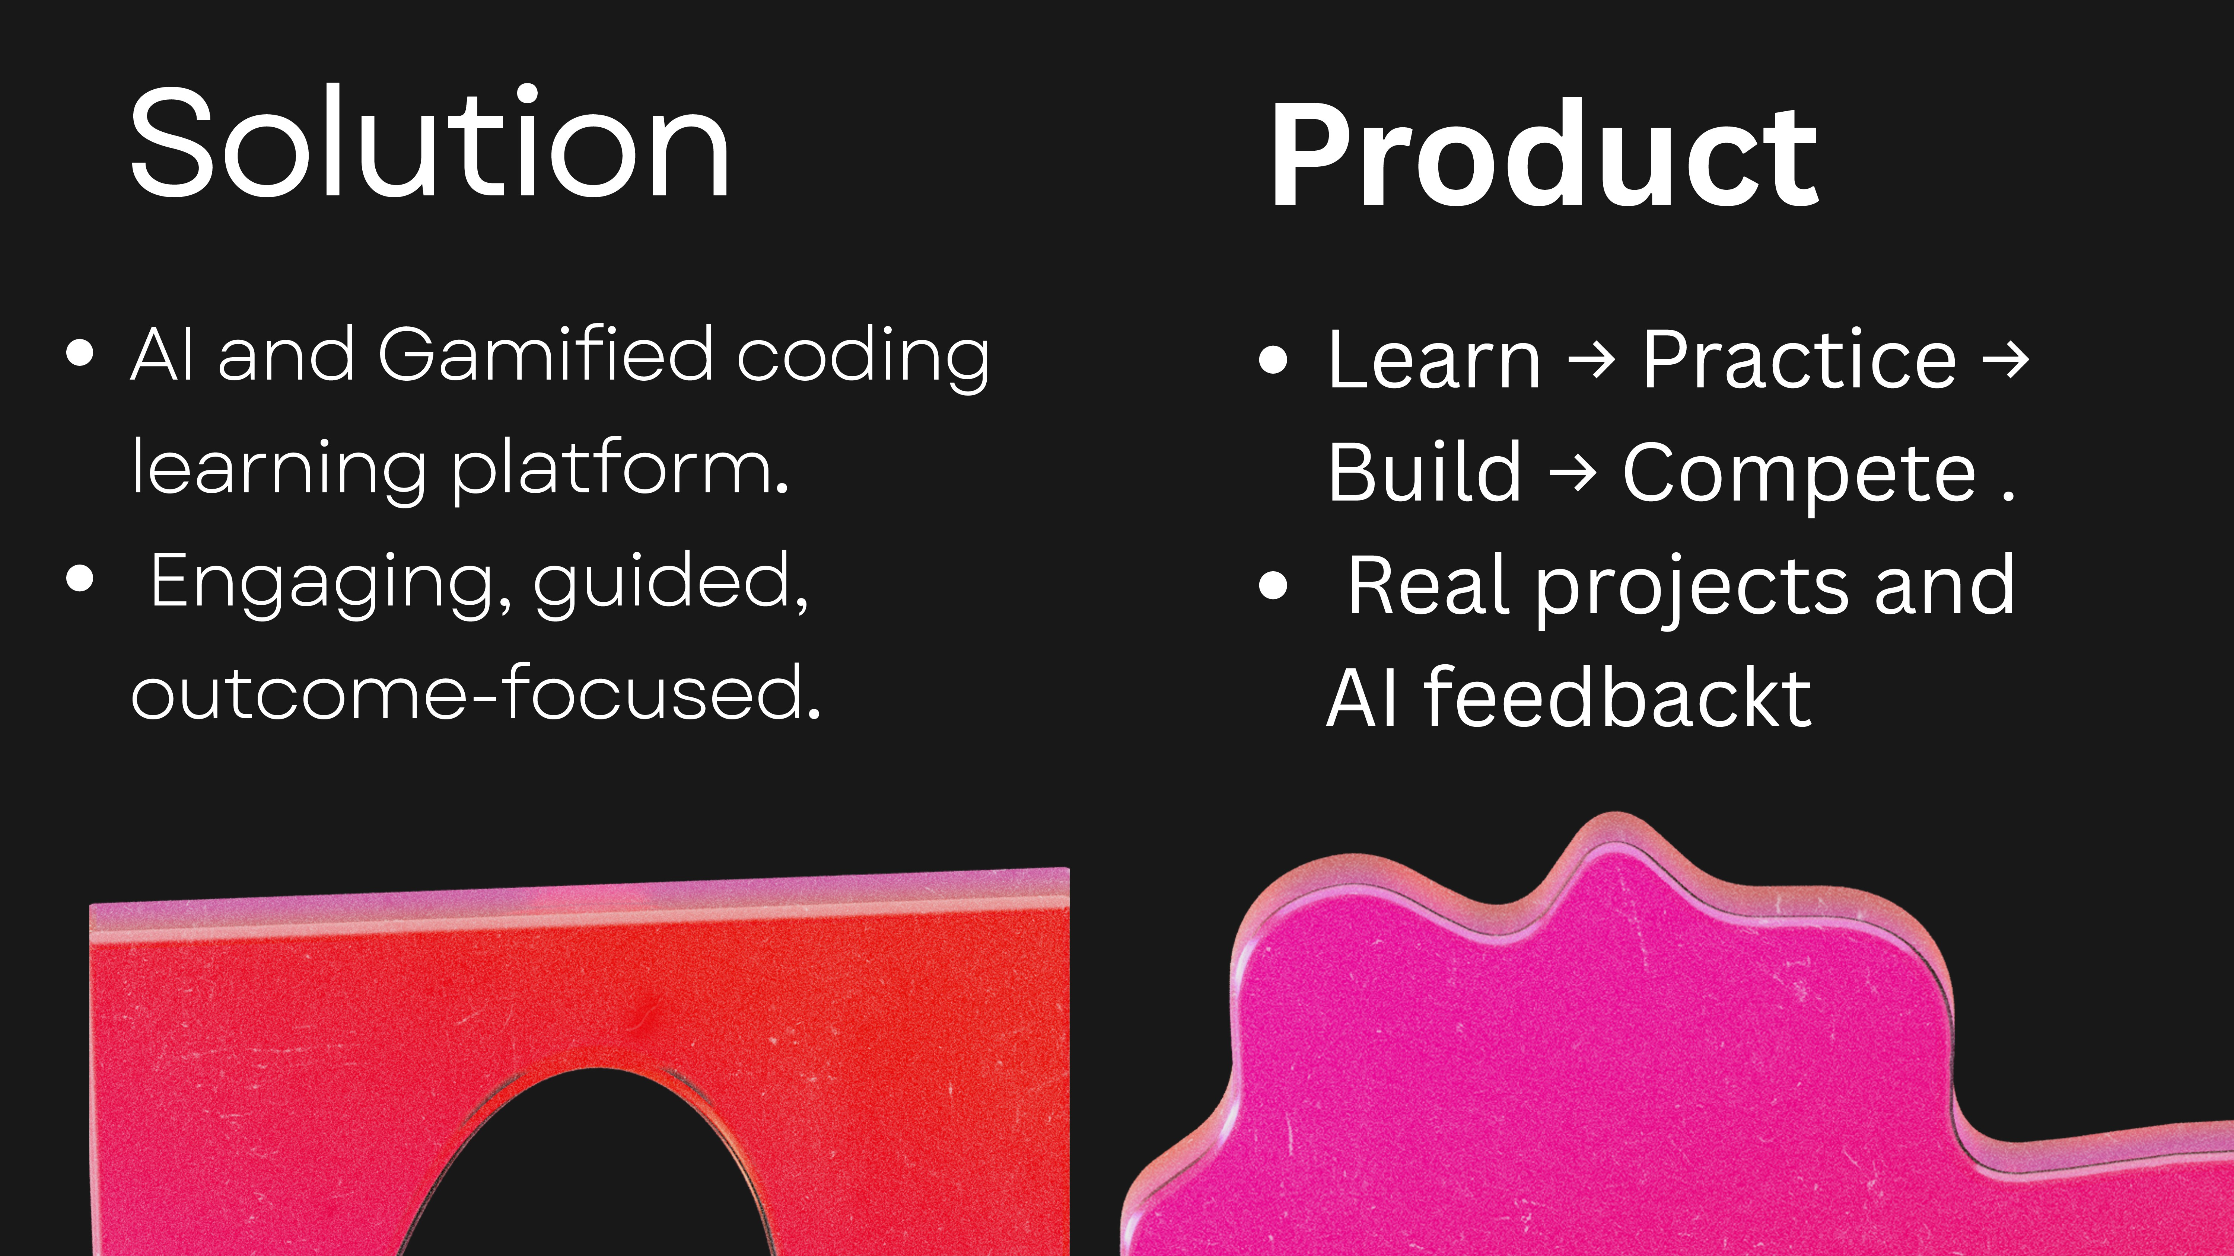

Slide 5
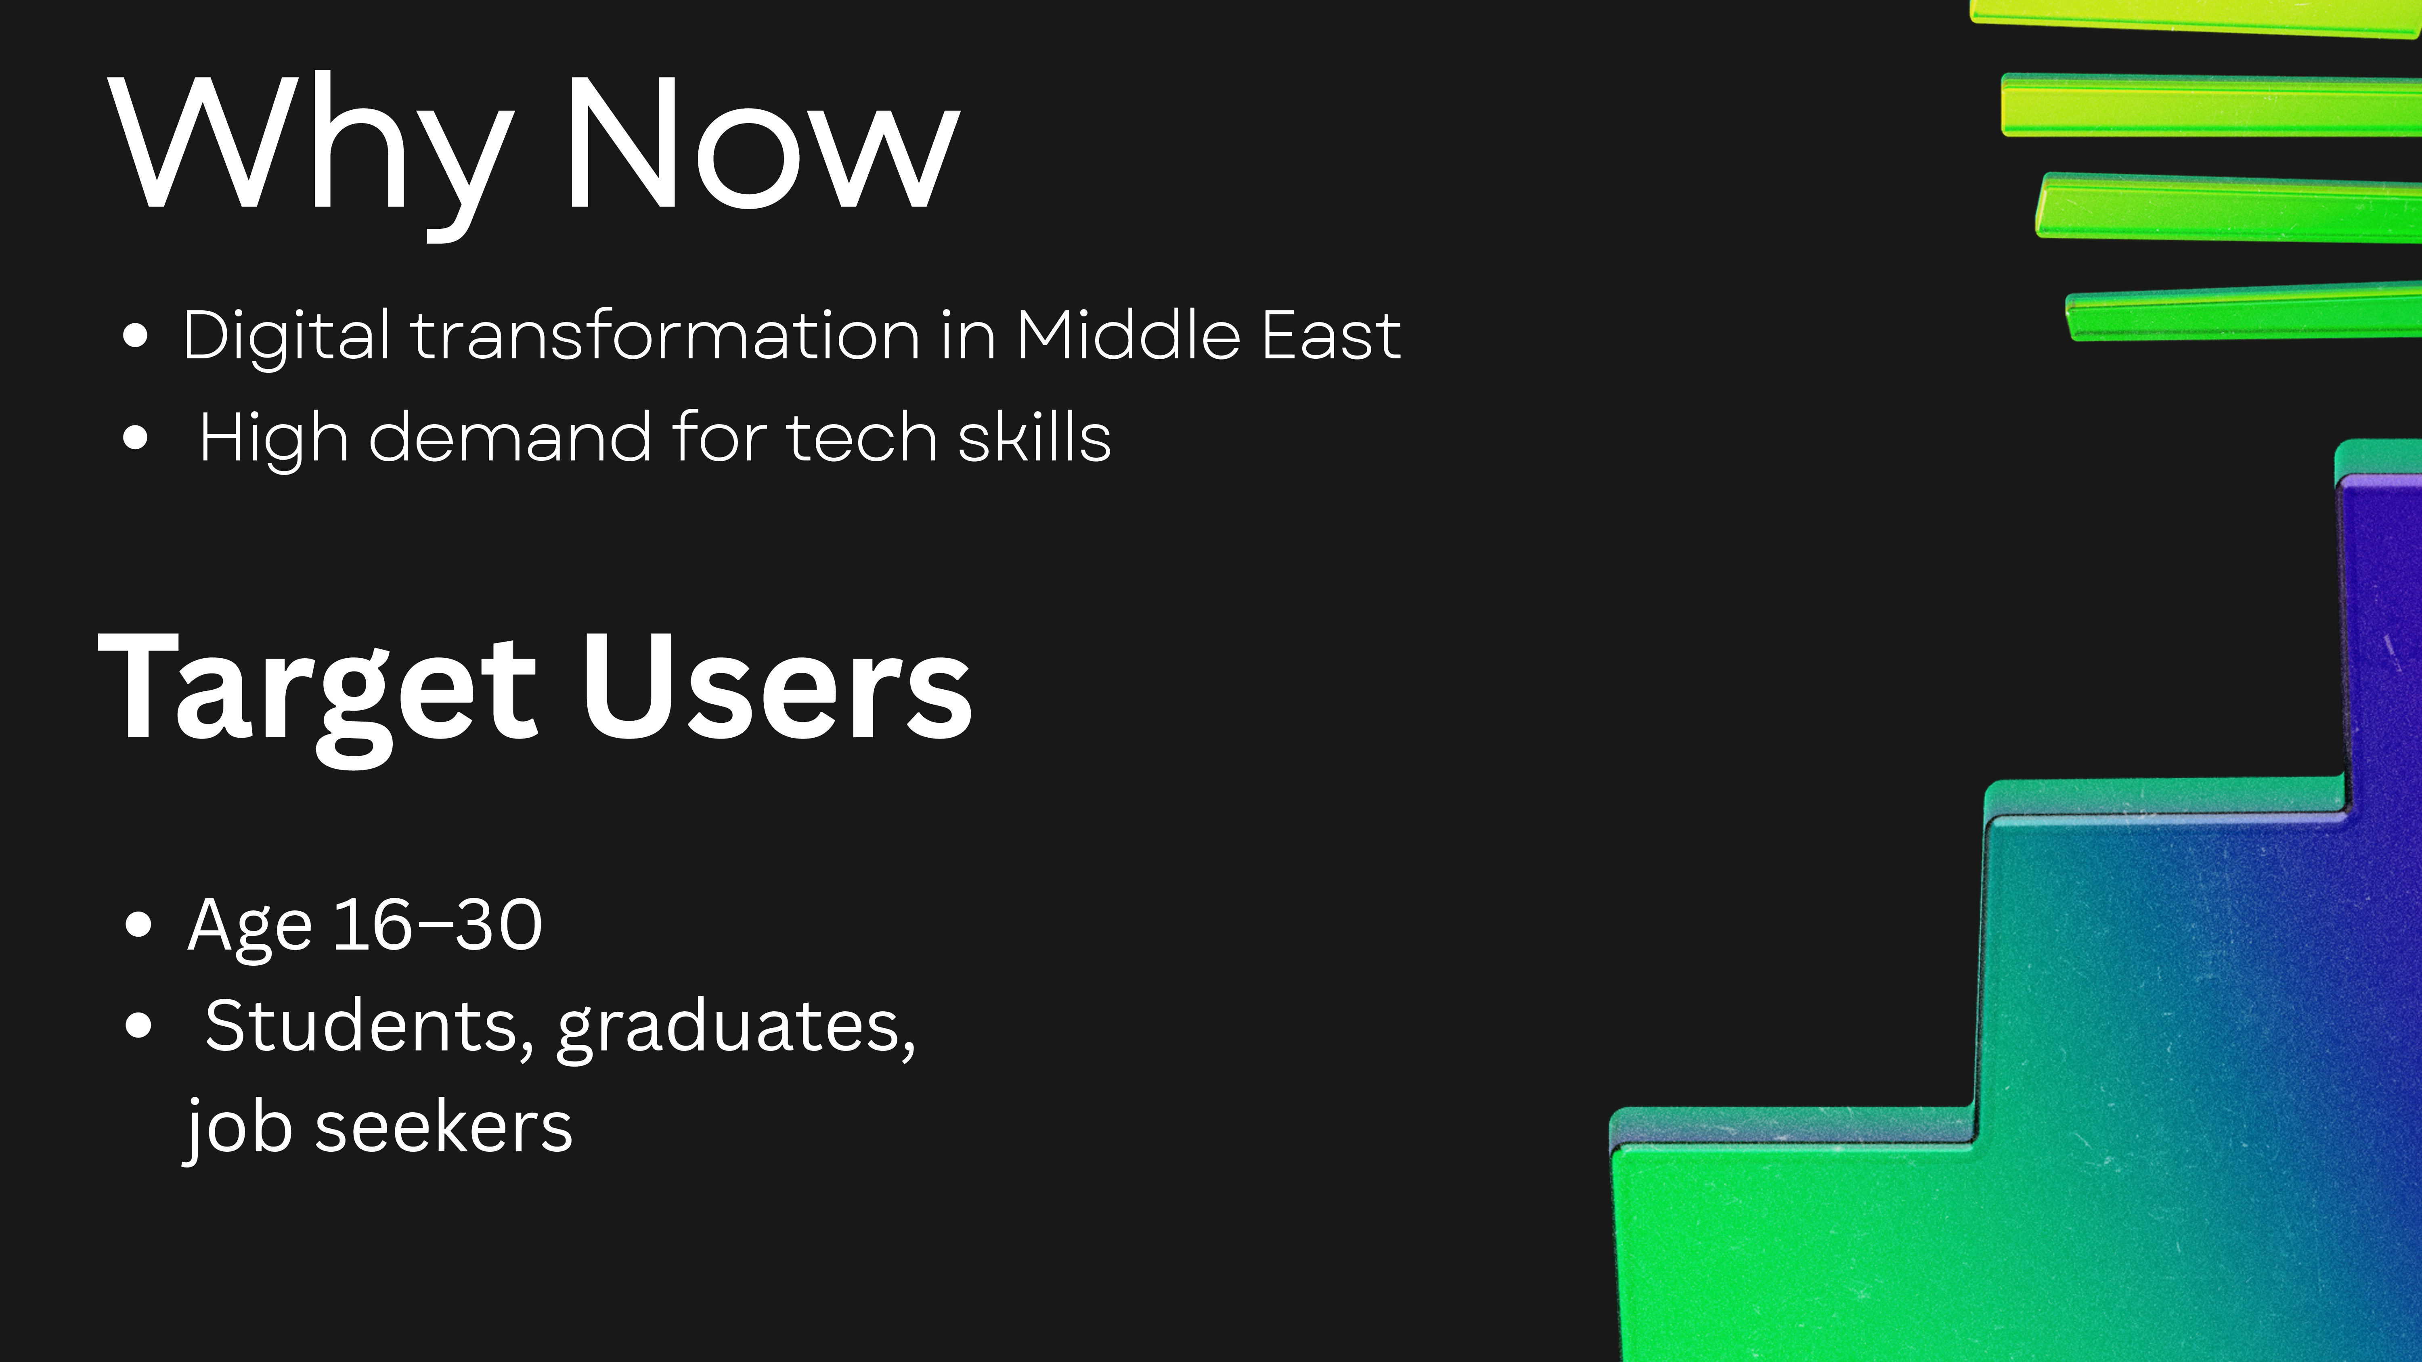

Slide 6
””
Freemium
ar

Slide 7

Tech communities
Higher engagement

Slide 8
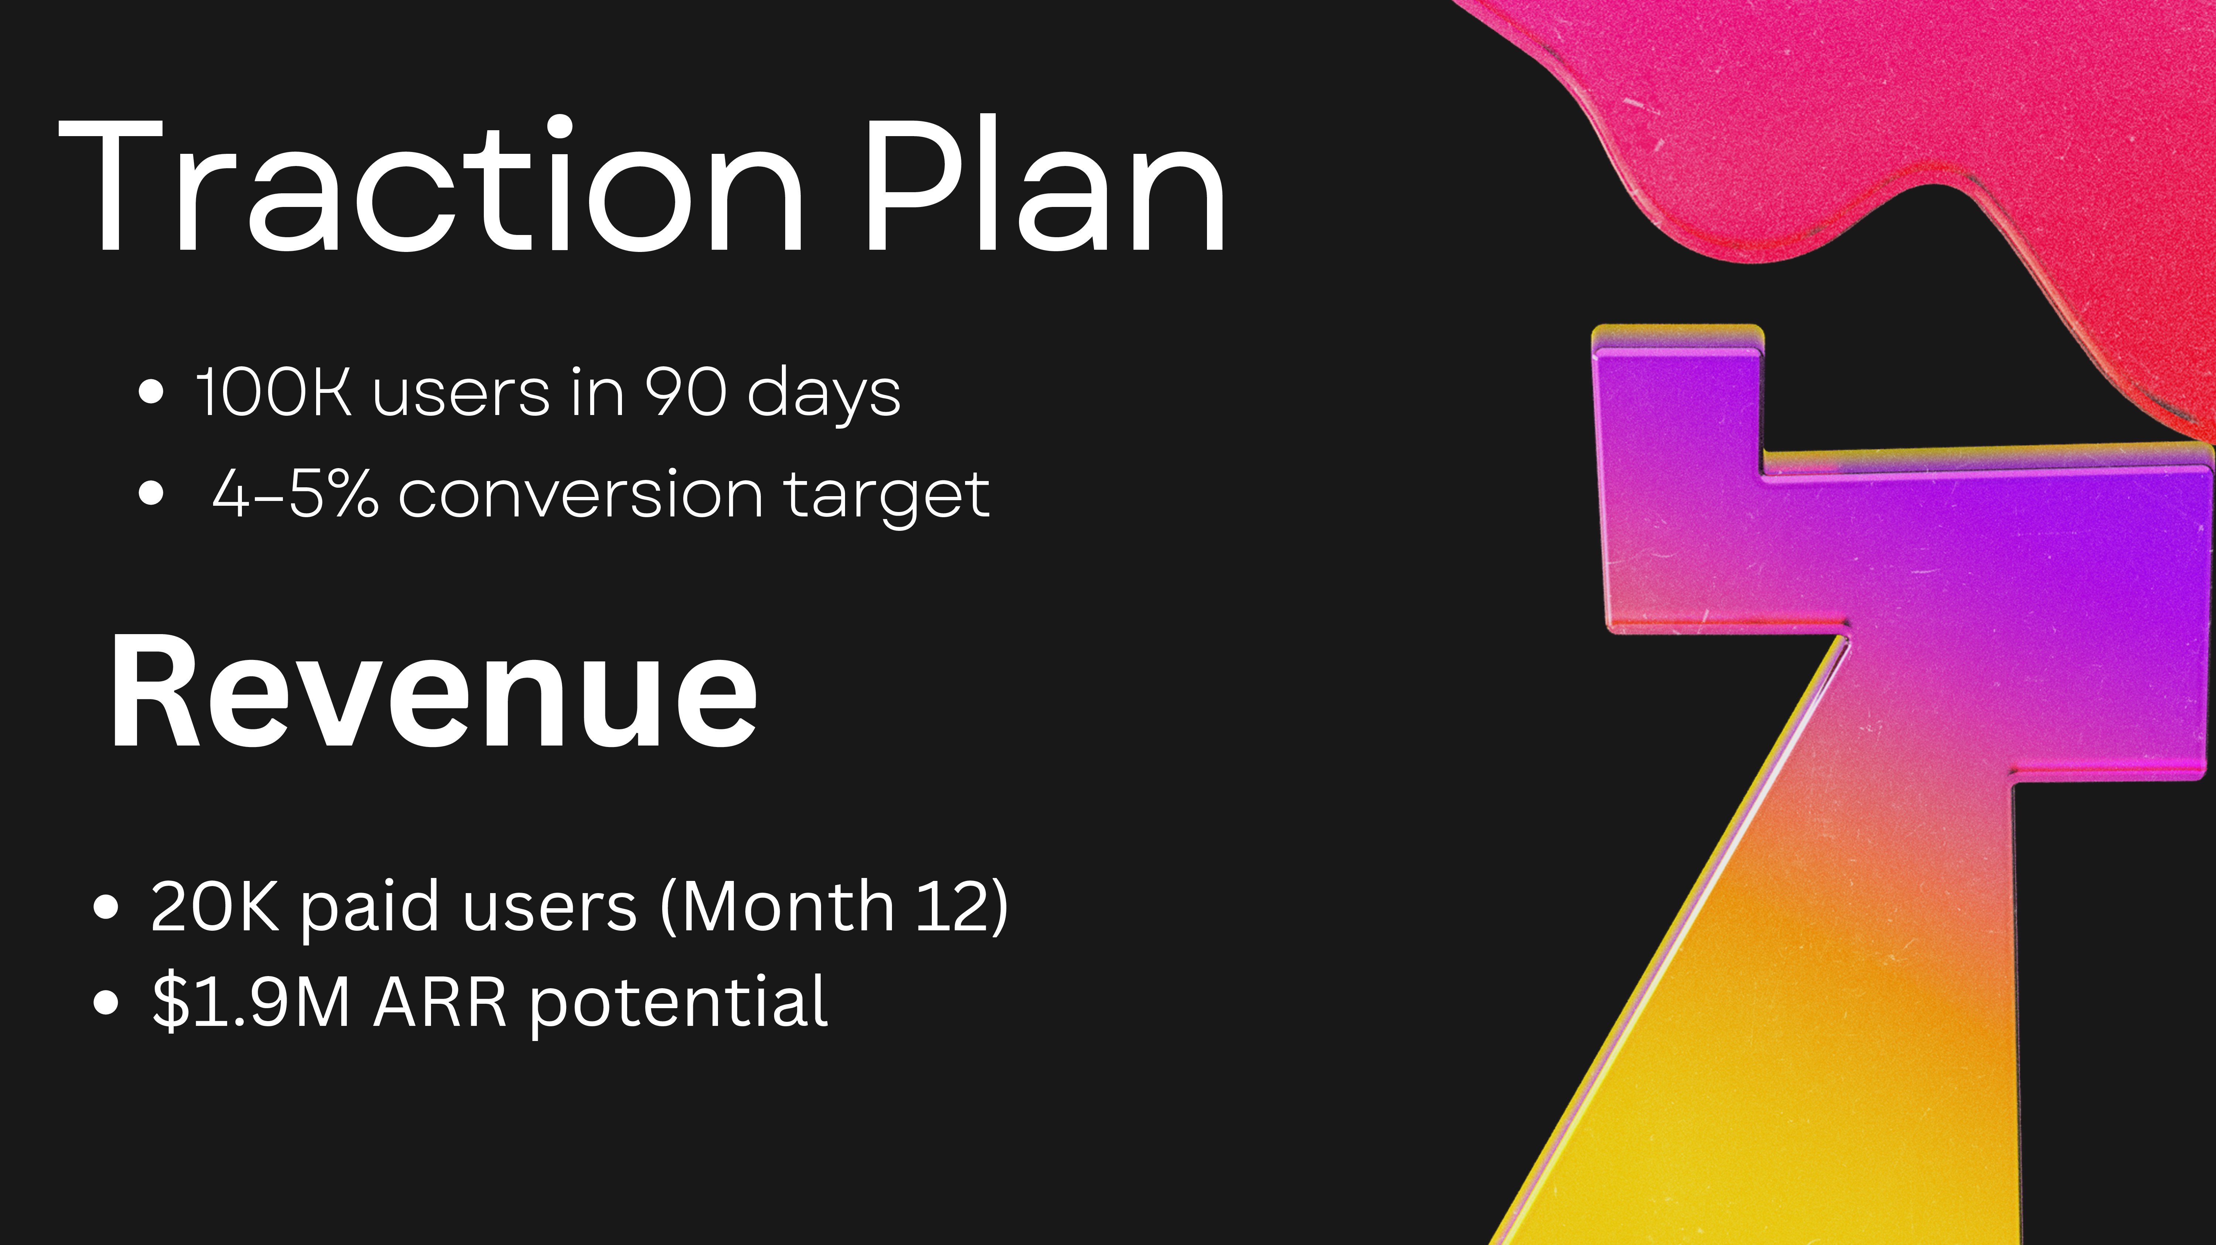

Slide 9

Low trust + influencers + proof

Slide 10







Use o
Timeìine an
MVP ready / in progress
Market research done
Launch pİan prepared
0—3 months: launch
6 months: 100K users
12 months: revenue scale
Marketing: 40%
Product/Tech: 30%
Content/Localization: 20%
Operations: 10%

